Slide 1
Attention
Chapter 2

Slide 2
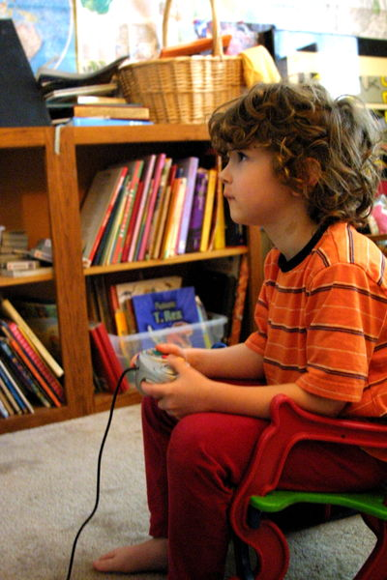
Definition: ‘the concentration of mental effort on sensory or mental events’,

Slide 3
Attention
Attention is very important for many human activity
Failures in attention cause accidents
Driver using mobile phones while driving
Control room operators not knowing which instrument to attend to
In order to make good design we need to understand the capabilities and limitations of attention

Slide 4
Attention 2
Attention is important in the design and operation of safety-critical interactive systems.
Two forms of attention:
selective attention
divided attention.

Slide 5
Selective Attention
Selective (or focused) attention generally refers to whether or not we become aware of sensory information.
Choosing to focus on one activity amongst many. Such as carrying out a conversation with a friend in a crowded room.

Slide 6
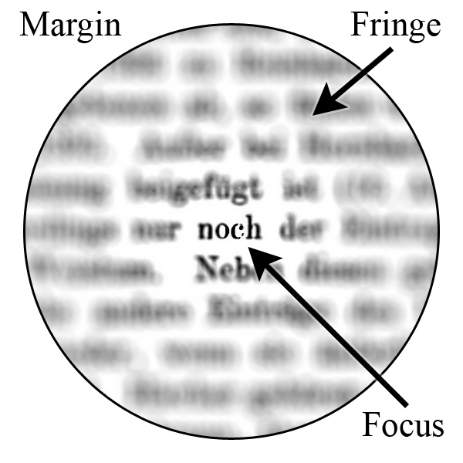
Selective Attention

Slide 7
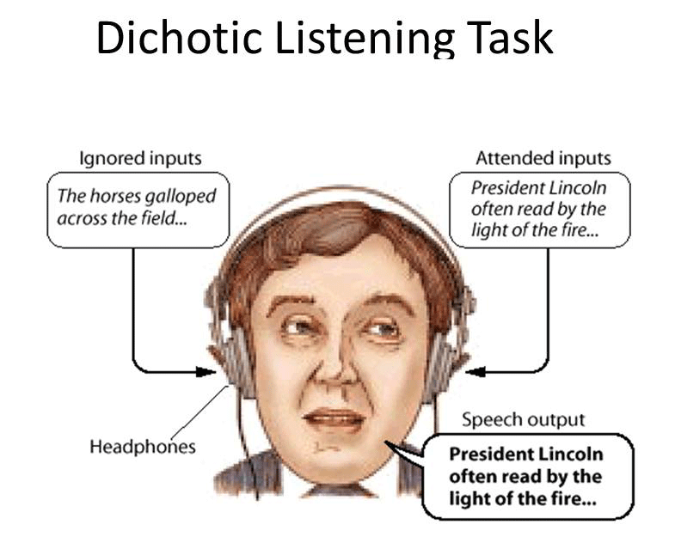

Slide 8
Divided attention
Divided Attention: Mental resources are divided between while multi-tasking.
Performance of two simultaneously executed tasks would be poorer than attending to just one at a time.
Watching TV and talking to a person
Talking on phone and driving a car

Slide 9
Divided Attention
Video
Count yellow stars
Count yellow stars + red crosses

Slide 10
Attention as capacity allocation
We have a limited amount of processing power at our disposal
some tasks require relatively little processing power and others require more
This explains how we can divide our attention across a number of tasks depending on
The demand level
Our experience in executing them.
Other variables that effect how allocate attention are:
Stress
enduring dispositions,
momentary intentions

Slide 11
Limits of Attention
Chapter 8: Shape Thought and Action
Reference Book: Designing with Mind in Mind

Slide 12
Overview
Limited capacity of attention and short term memory
This dictates that people interact with the world in predicable patterns
Interactive systems are more suitable when they are designed with these limitation in mind
6 patterns of human behavior when interacting with the world including interactive systems

Slide 13
Patterns
WE FOCUS ON OUR GOALS AND PAY LITTLE ATTENTION TO OUR TOOLS
WE USE EXTERNAL AIDS TO KEEP TRACK OF WHAT WE ARE DOING
WE FOLLOW INFORMATION “SCENT” TOWARD OUR GOAL
WE PREFER FAMILIAR PATHS
OUR THOUGHT CYCLE: GOAL, EXECUTE, EVALUATE
AFTER WE ACHIEVE A TASK’S PRIMARY GOAL, WE OFTEN FORGET CLEANUP STEPS

Slide 14
Focus on Goals not Tools
Machines, computers, pens etc are all tools to achieve specific goals
Humans focus/pay attention on their goals and not on the tools they use
We are blind to the tools because of the limits of
Attention
Short Term Memory
Focusing on Tools makes us forget the goal

Slide 15
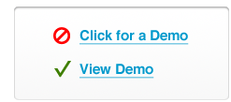
Focus on Goals not Tools
Design in a way so that the software don’t call attention to itself
So that user focuses on the task not the software
For example when designing web pages do not use words like click here as it draws attention to the tool (mouse)

Slide 16
We Use External Tools to Keep Track
Due to the limits of attention and short term memory
We use marks to help us remind
Reading books → bookmarks
Addition → do on paper
Counting → we move objects if we can (like prayer beads)
Email applications → tell us which emails are read, which have been replied to etc

Slide 17
Design Rule
Interactive systems should allow user to move or mark objects to indicate which ones they have worked on

Slide 18
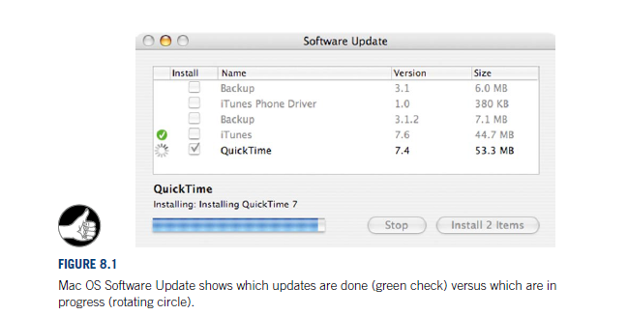
Example for Design Rule: Marking or moving objects

Slide 19
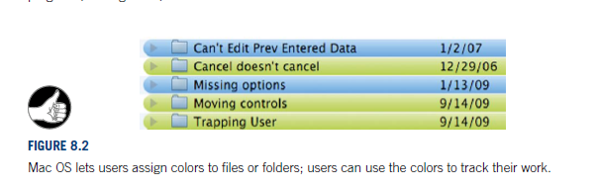
Example for Design Rule: Marking or moving objects
For example you can mark pictures that you have already edited

Slide 20
Information Scent to Goal
When doing something
We take menu instructions very literally
We don’t think too deep about it
If someone wants to buy a airline ticket on a website
Scan for buy, ticket, reservation etc
Will ignore text like hotel

Slide 21
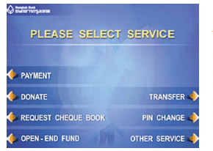
Information Scent : ATM Menu
What will the user notice for each of the following goals
Pay a bill
Pay dentist by transfer funds
Open New Account

Slide 22
Design Rule
“interactive systems should be designed so that the scent is strong and really does lead users to their goals”.
To do that,
Designers need to understand the goals that users are likely to have at each decision point in a task
ensure that each choice point in the software provides options for every important user goal
clearly indicates which option leads to which goal.

Slide 23
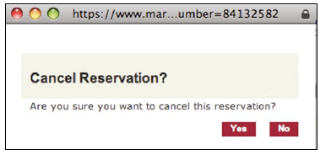
Cancelling Transaction
Good

Slide 24
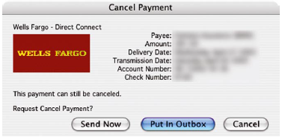
Cancelling Transactions
Bad

Slide 25
Another Example
When we try to open a document which has already been opened Word and Excel use different wording, which one is clearer?

Slide 26
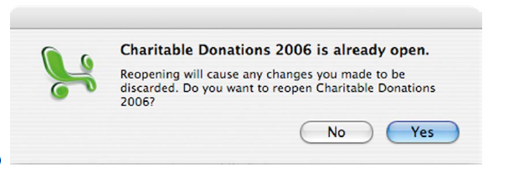
Another Example
Excel

Slide 27
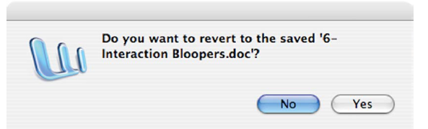
Another Example
Word

Slide 28
We Prefer Familiar Paths
While achieving a goal, we take familiar paths not explore new ones
Especially when we have a deadline
Exploring new paths is problem solving and it is heavy on attention and short term memory
Familiar paths are almost automatic
While using a software, w stick to our old habits, even when told that there is a better way

Slide 29
Familiar Paths: Design Leason
num of key stokes is not critical in some cases like:
Design infrequent use softwares like ATM so that they are tuned to avoid problem solving
Frequent use software number of key strokes is important
People become experts with time
They might be formally trained to use it
E.g. 911 systems (police reporting). Every key stoke is important

Slide 30
Familiar Paths: Design Leason (2)
Guide user to the best paths
Home screen should have some sort of information for user to use
Help experienced user to speed up
As they gain experience show them faster paths
Make it easy for them to shift

Slide 31
Goal, Execute, Evaluate
Our thought cycle is Goal, Execute and Evaluate
Goal: Form a goal, e.g. open a bank account
Execute: take steps towards the goal e.g. go to the bank
Evaluate: Check if goal is achieved
Repeat until goal is achieved

Slide 32
Goal, Execute, Evaluate
A software should help user in each of these aspects
Goal:
Provide clear paths
including initial steps for the user goals that the software is intended to support.
Execute:
The software should provide clear instructions and make it easy for the user to accomplish his/her task
Evaluate:
Provide feedback and status information to show users their progress toward the goal.
Allow users to back out of tasks that didn’t take them toward their goal.

Slide 33

Goal, Execute , Evaluate
A travel website showing the user the whole Goal, Execute , Evaluate path

Slide 34
Forgetting to Clean Up
Since attention is a scarce resource, user forget to clean up after a task is finished
People leaving car lights on a rainy day
Software should be designed so that they automatically do clean up or remind the user to properly finish their task
E.g. car beeping if you leave the head lights on

